Slide 1

Disney + HotStar Data Analysis
Naveen Ramesh
BADM-WD-T-B5

Slide 2

About Disney+Hotstar
Disney+ Hotstar is a streaming service that offers a variety of content, including movies, TV shows, live sports, and Disney+ originals. It also features content from Disney's main brands, such as Pixar, Marvel, Lucasfilm, and National Geographic.
Disney+ Hotstar is owned by Novi Digital Entertainment Private Limited, a subsidiary of Star India Private Limited. In 2019, Disney acquired 21st Century Fox, the parent company of Star India, and integrated Hotstar into Disney's global streaming brand in 2020.
Founder(s): Star India
Launched: 11 February 2015; 9 years ago
Parent: JioStar

Slide 3

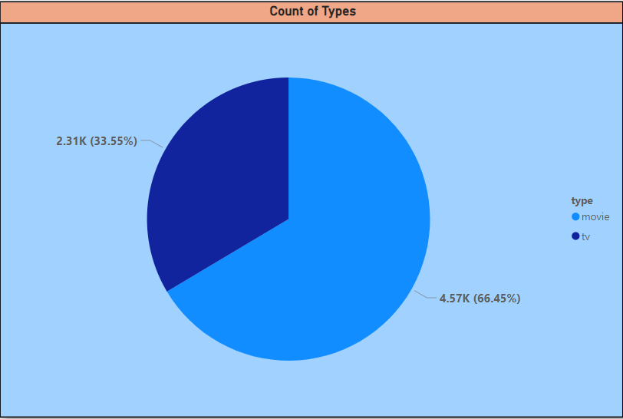
Problem Statement & Dataset
To Provide an in-depth analysis and visualization of a movie dataset to uncover insights and trends. This includes understanding the distribution of movies by genre, running times, release years, age ratings, and other attributes.
Data Set Explanation:
hotstar_id: Unique identifier for each movie
title: Title of the movie
description: Short description of the movie
genre: Genre of the movie
year: Release year of the movie
age_rating: Age rating of the movie
running_time: Duration of the movie in minutes
seasons: Number of seasons (for series)
episodes: Number of episodes (for series)
type: Type of content – Movies: 4.57K(66.45%) and TV Shows: 2.31K(33.5%)

Slide 4
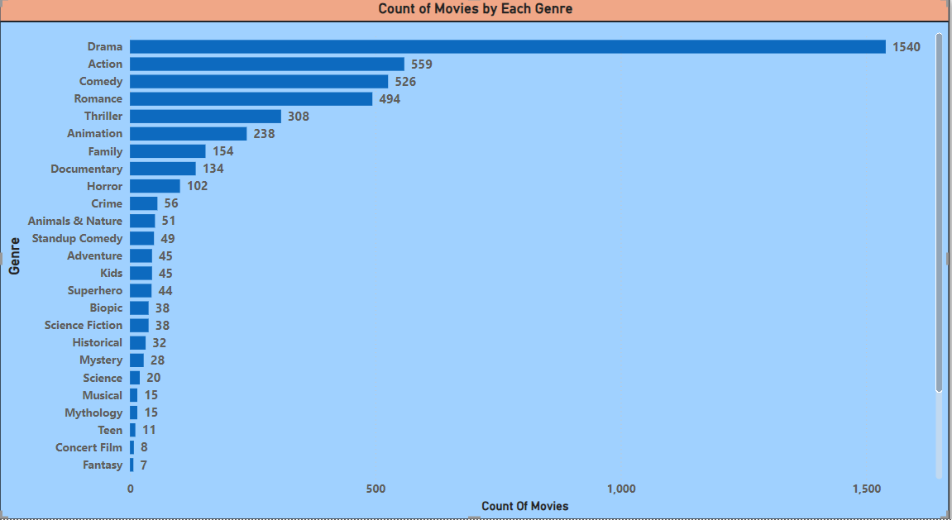
Distribution of Movies by Genre
This chart shows the count of movies for each genre.
Drama genre has the highest number of movies with the count 1540, followed by Action genre(559) and comedy genre(526)
Food, Travel and Talk show genre with the least number of movies with the count of 1 each.

Slide 5
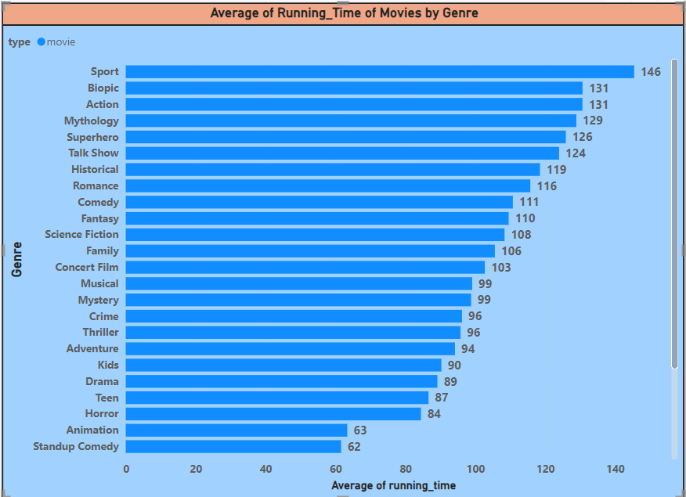
Average Running Time of Movies by Genre
This chart shows the average running time for movies in each genre.
Genre like sport(146) and biopic(131) has the movies with the highest running time compared to science(38) and travel(18).

Slide 6
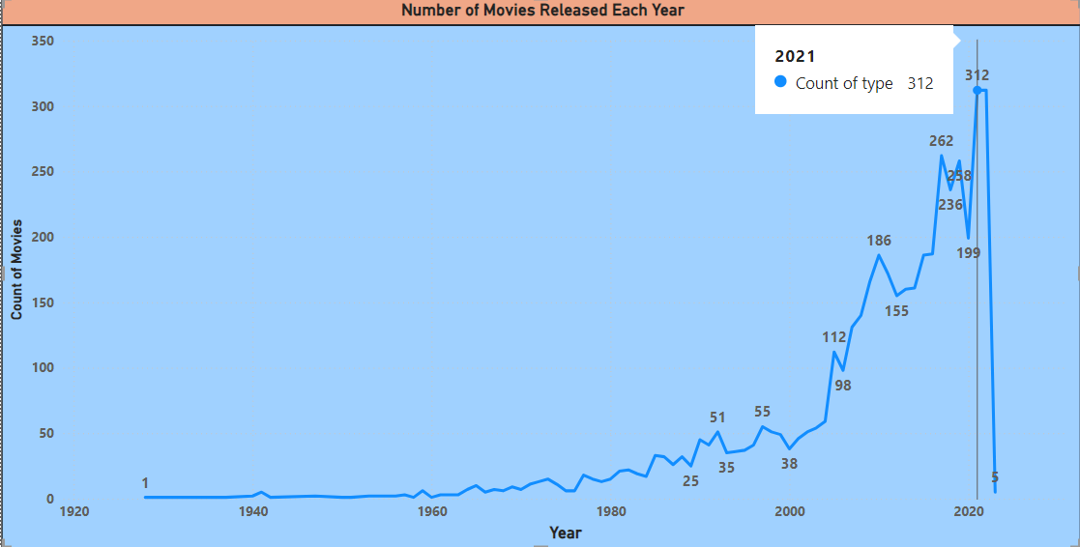
Movies Released Each Year:
This line chart shows the number of movies released each year.
The chart shows the movies released from 1928 to 2023 and can find that the peak starts from the year 2000 and attained the highest peak in the year 2021 & 2022(count 312).

Slide 7
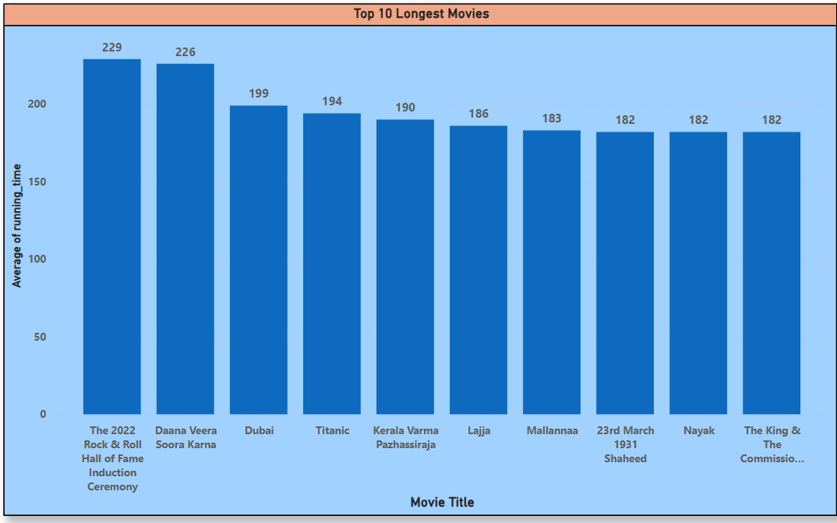
Top 10 Longest Movies
This chart shows the top 10 longest movies based on running time.
The longest movie is “The 2022 Rock & Roll Hall of Fame Induction Ceremony with the running time of 229min followed by Daana Veera Soora Karna(226), Dubai(199), Titanic(194), etc.

Slide 8
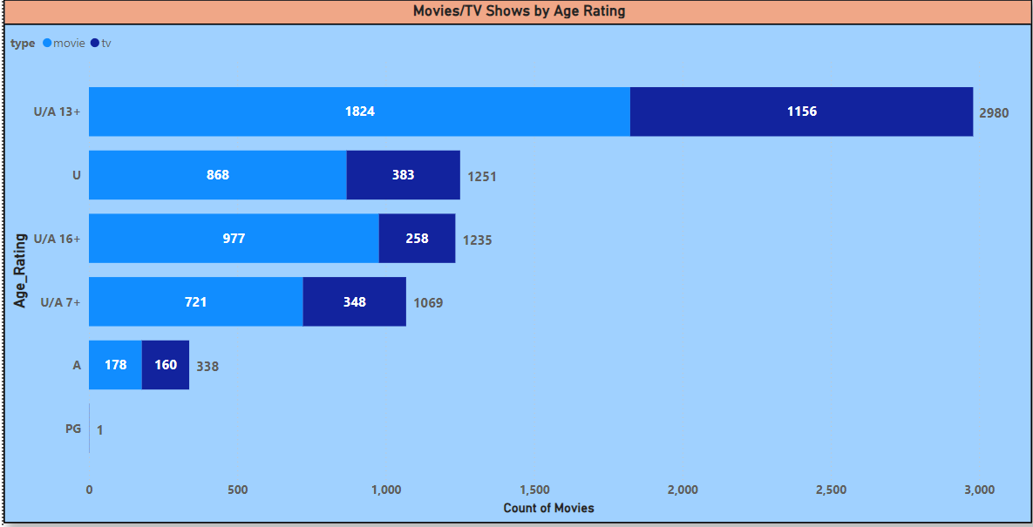
Movies & TV Shows by Age Rating
This chart shows the distribution of movies & TV shows by age rating.
The moves and TV shows with the U/A 13+ content has the highest numbers with 2980, followed by U and U/A 16+.
The least is A content, due to the Adult and violence content it possess.

Slide 9
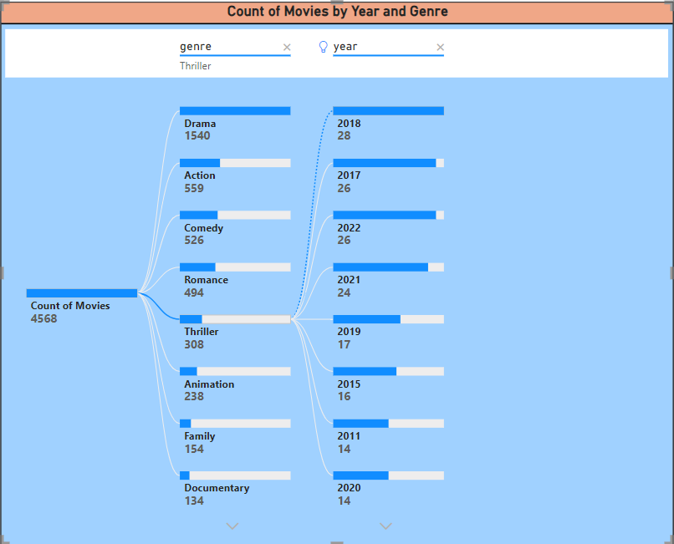
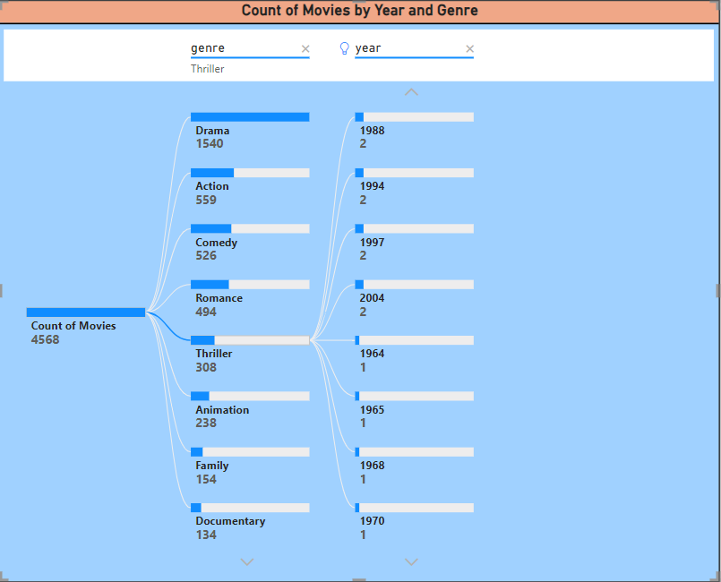
Count of Movies by Year and Genre
This chart analysis the count of movies for each genre over the years.
For example, the Thriller genre has 308 movies in total released over the years. In 2018, 28 Thriller moves were released which is the highest and the least is from the years 1964 to 1970.

Slide 10
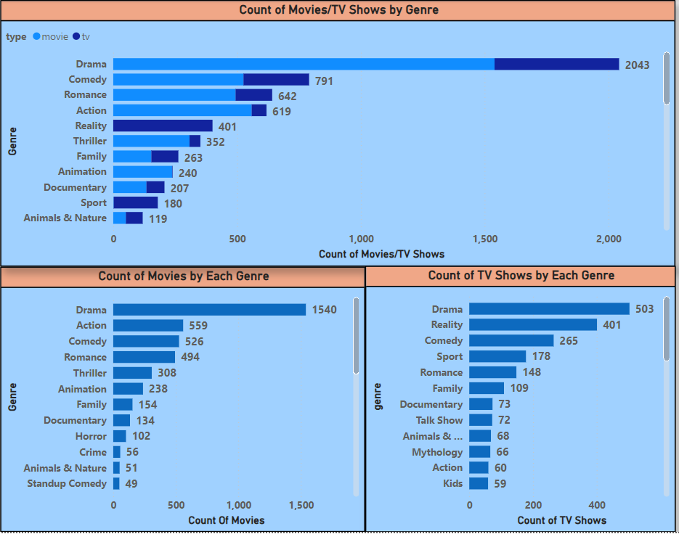
Most Common Movie & TV Shows
This chart shows number of movies & TV shows in each Genre.
The most common movie & TV show Genre is Drama(2043) followed by Action in Movies and Reality shows in TV shows.
The least is Standup Comedy in Movies and Kids shoes in TV shows.

Slide 11
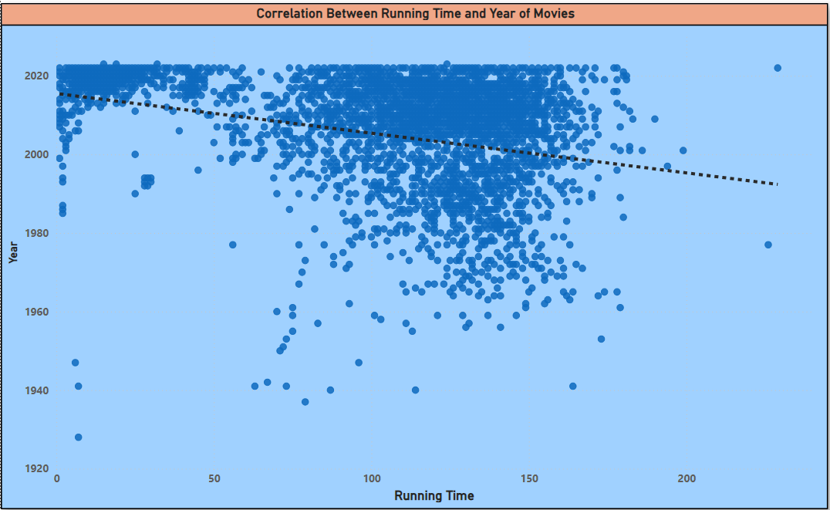
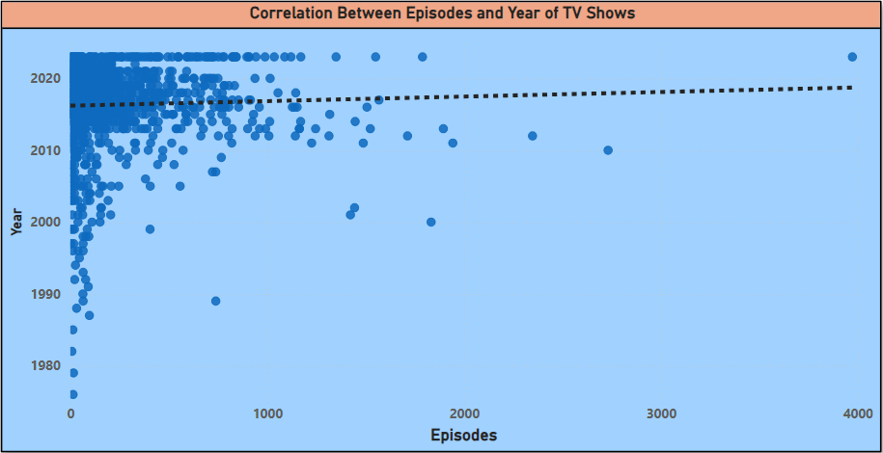
Correlation Analysis
This Scatter Chart describes the Correlation Analysis(Correlation Coefficient is -1 to 1)Between Running time and Year of Movies and Episodes and Years of TV shows.
The Running Time and Year is negatively correlated, as we can see slight dip in the trend line, ie)when the year increases the running time of movies deceases.
The Episodes and Year is Moderate positively correlated, as we can see rise in the trend line, ie)when year increases episodes count also increases.

Slide 12
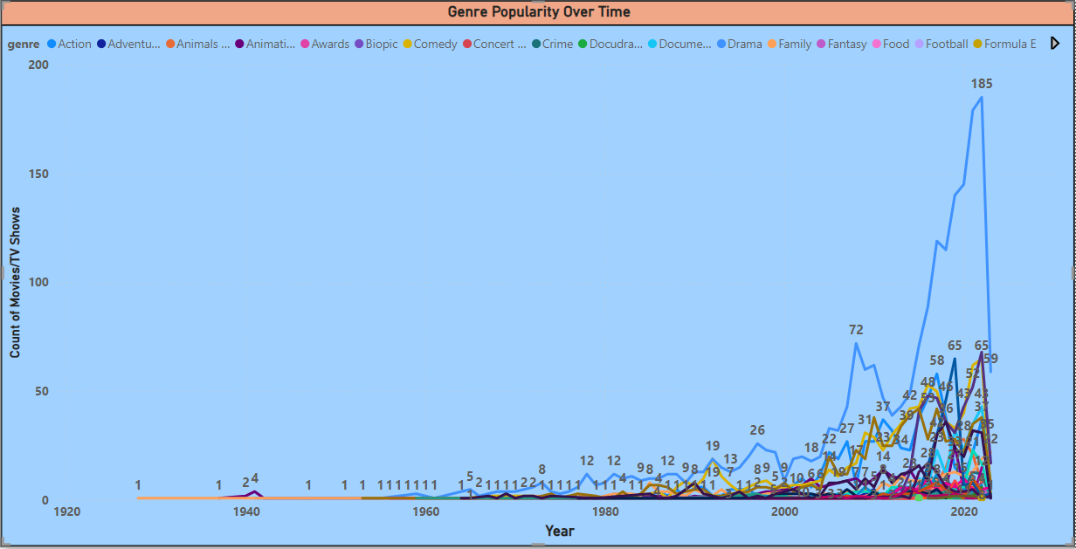
Genre Popularity Over Time
This line chart to shows the popularity of different genres has changed over time.
The Genre Drama has the consistent rise in popularity with the peak in 2005 and till now.
In 2022, the highest number moves released in Drama genre(185 movies).
Genre like Action and Romance has also attained the popularity over the years.

Slide 13
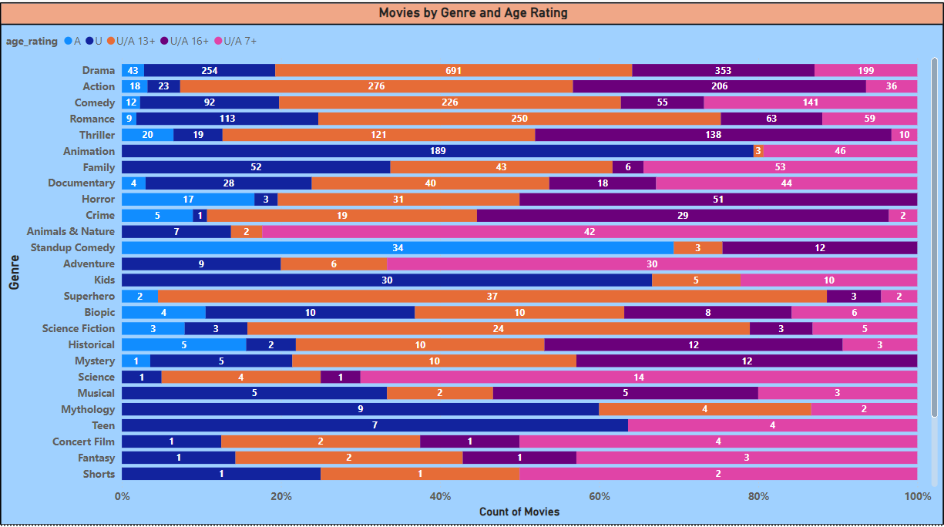
Movies by Genre and Age Rating
This Chart the analysis the movies by genre and age rating.
The Genre Drama has the highest number of movies in U/A 13+ content followed by U/A 16+ and U ratings.
The least is Fantasy and Shorts Genre.

Slide 14
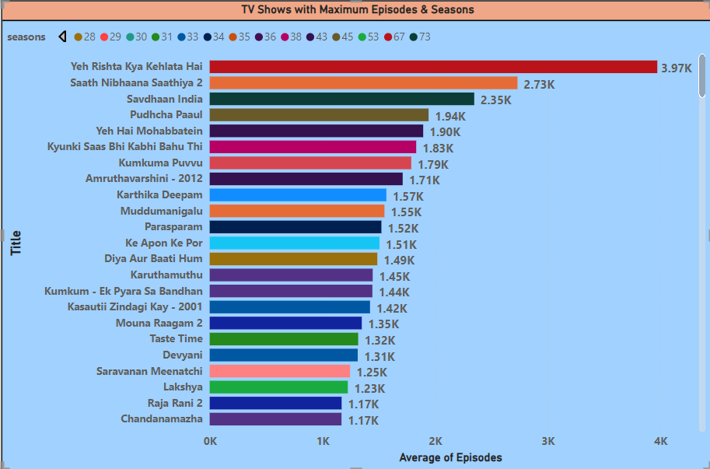
TV Shows with Maximum Episodes
This chart analysis the TV shows with the maximum number of episodes.
The TV show with the highest episodes include Yeh Rista Kya Kehlata Hai with 3.7K episodes, followed by Saath Nibhaana Saathiya 2 with 2.73K.
The least is The Great Indian Disruptors with 5 episodes.

Slide 15
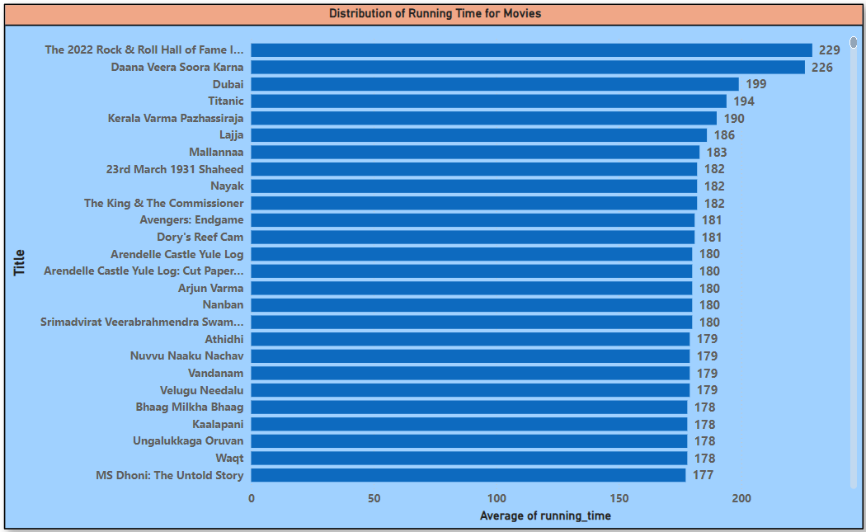
Distribution of Running Time
This chart shows the Distribution of all movies based on running time.
The longest movie is “The 2022 Rock & Roll Hall of Fame Induction Ceremony with the running time of 229min followed by Daana Veera Soora Karna(226), Dubai(199), Titanic(194), etc.

Slide 16
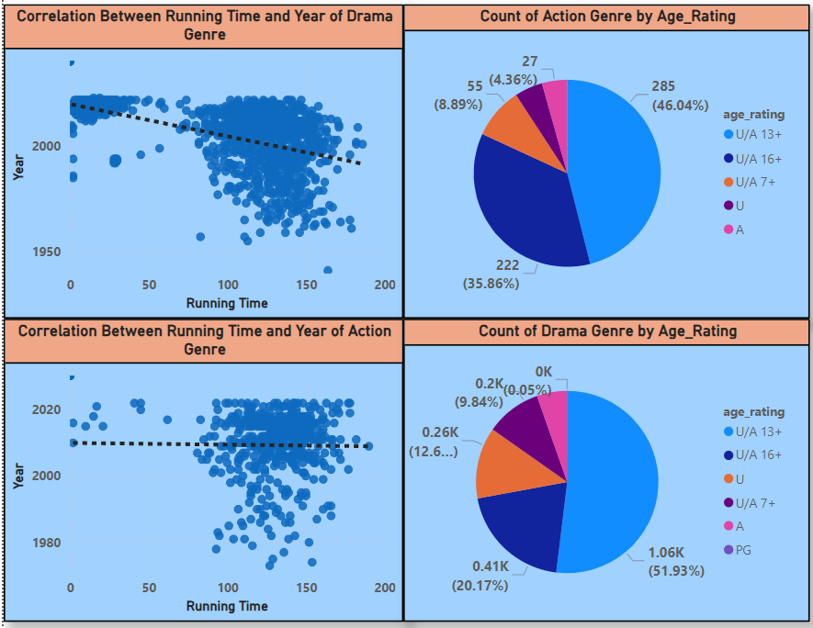
Analysis of Specific Genres
This Scatter Chart describes the Correlation Analysis(Correlation Coefficient is -1 to 1).
The Running Time and Year of Drama is negatively correlated, as we can see dip in the trend line, ie)when the year increases the running time of Drama deceases.
The Running Time and Year of Action is negatively correlated, as we can see slight dip in the trend line, ie)when the year increases the running time of Action deceases.
Drama has most 13+ contents, whereas the Action Genre also has most 13+ content.

Slide 17
Business Recommendations
The Business Recommendations are as follows based on the Analysis we have seen:
Hotstar can buy more Drama and Action genre moves as well as TV shows has moved of the audience prefer to watch these Genres which is available 13+, 16+ and U age ratings.
Audience prefer movies with less running time, so Hotstar can focus on the content with the less running time. Audience prefer TV shows with the more episodes
Drama & Action genre can also be concentrated has audience preferred this genres over the years with the peak starts from 2005 and expected to increase the viewership in future too.
After Covid there is increase in moves in Hotstar and also the viewership increased. Audience mostly prefer 13+, 16+ and U contents rather than A content.
Viewership of series also increased when TV shows are concerned especially in Drama genre rather in Romance genre.

Slide 18
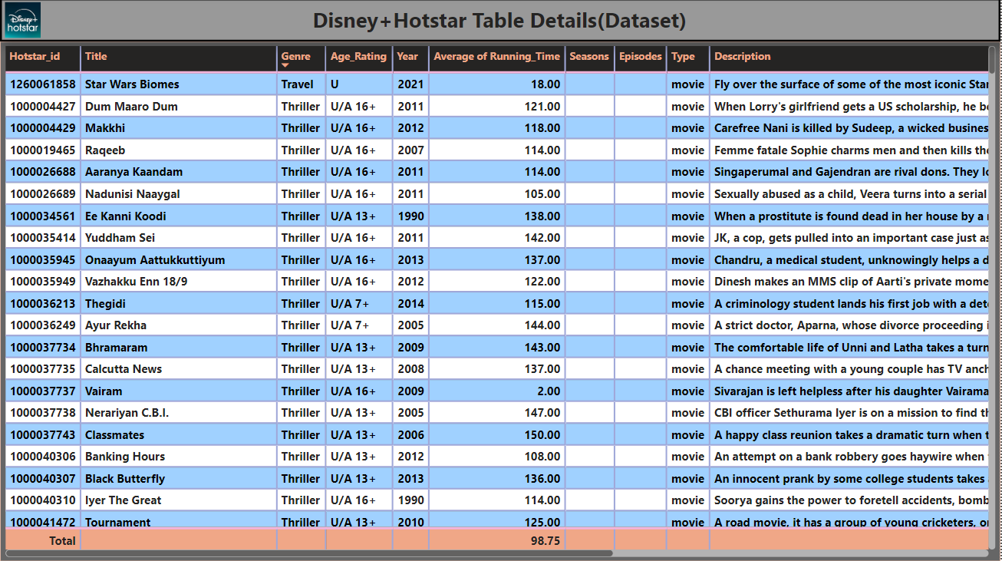

Slide 19
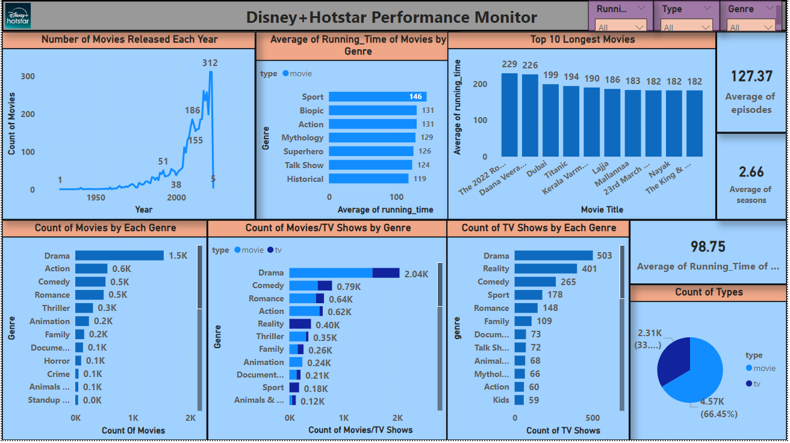
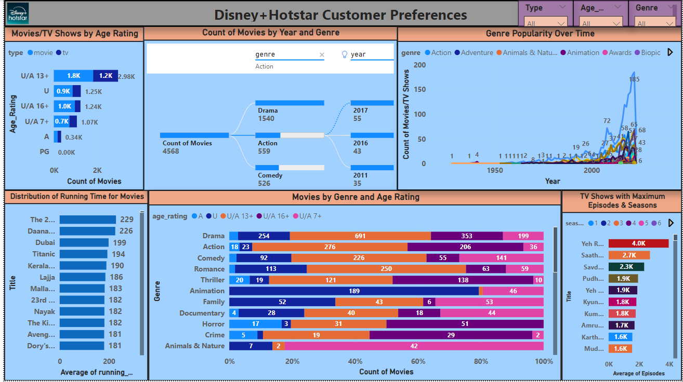
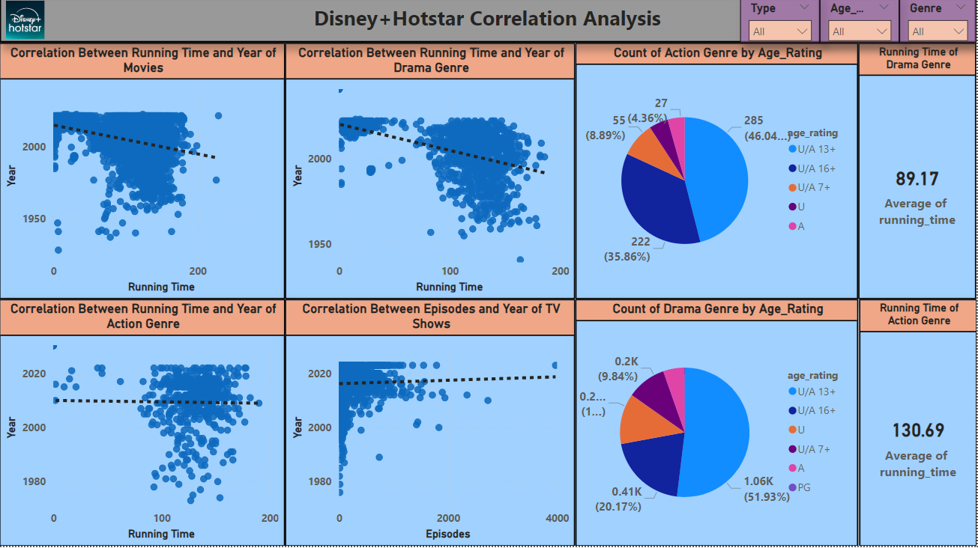
Dashboard's

Slide 20
Thank You!

